Slide 1
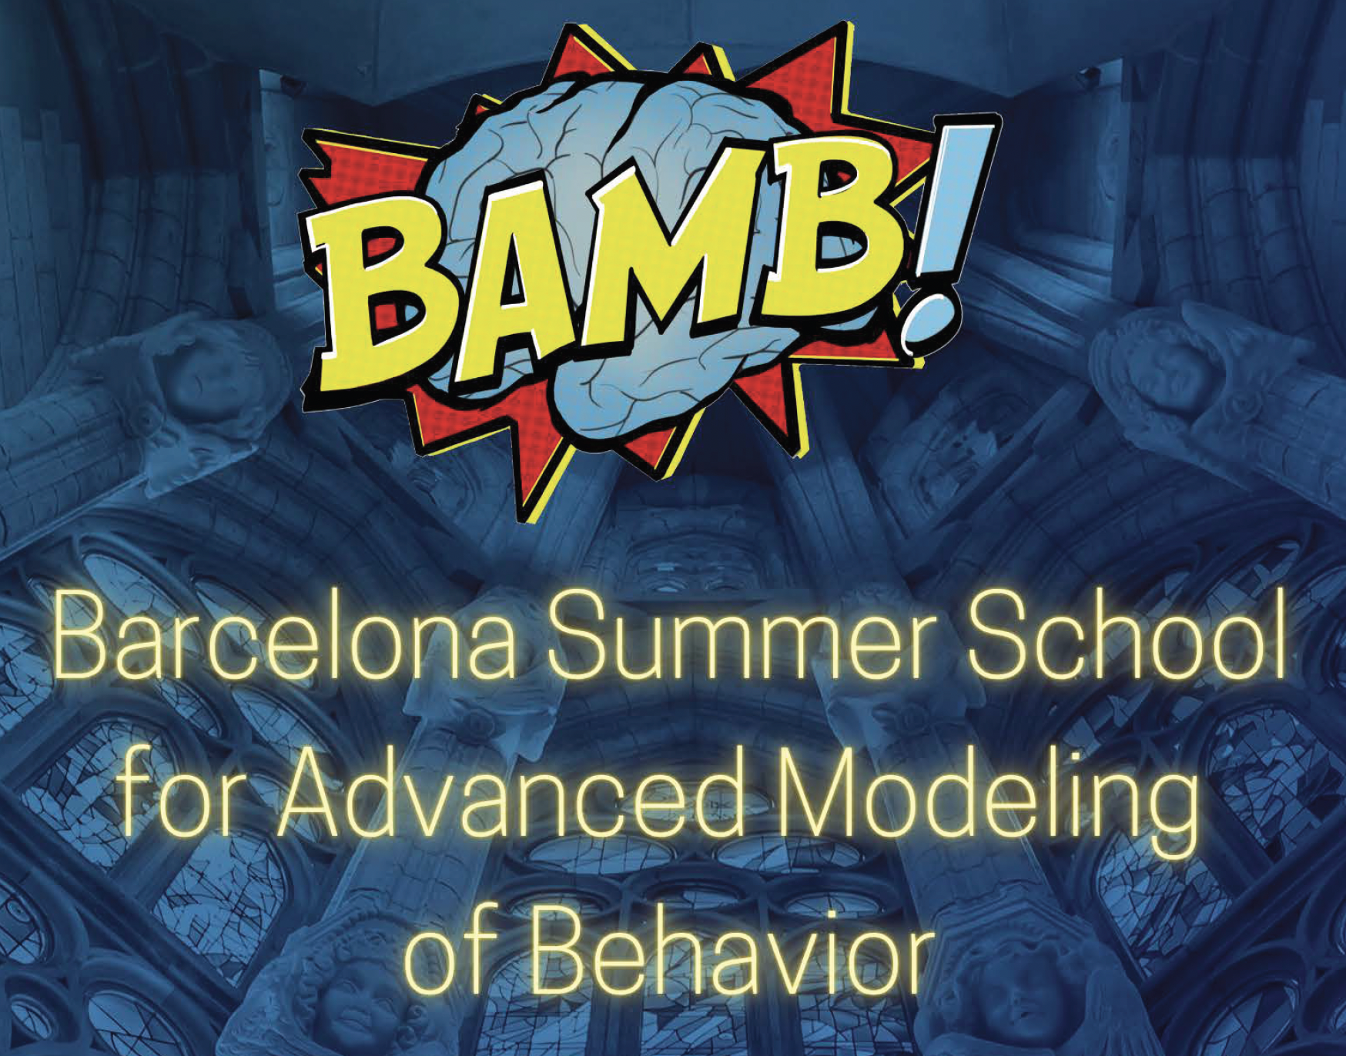

Slide 2

Course Structure
Lectures
Tutorials (lead by TAs)
Scientific keynote talks (by Athena Akrami and Peter Dayan)
Group project
One-on-ones: schedules emailed

Slide 3
Norms & advice
Please show up / be on time!!!
Speak up! Let us know if you need help with anything
Keep Slack open for information
Feedback will help us grow: survey will be sent at the end
It’s a packed schedule, but don’t overdo it
Don’t lose your badge
No drinks in the sala please

Slide 4
Safety & wellbeing
Please be respectful of others. There is a code of conduct in the booklet. Please let us know if you feel uncomfortable about anything.
If you feel unwell, please rest and recover – also, remember Covid is still a thing, please get tested if you have symptoms
Have fun, but the course is intense – look after yourself.
Barcelona is generally safe but be on your guard, especially at night.

Slide 5

Bon Viatge!!

Slide 6






What is a model?
Christopher Summerfield
University of Oxford
BAMB! Summer School 2025
funding
Notes:
Thank you all for coming, it’s a particular pleasure to be here at NYU.
Much of the work that I’m going to describe has been directly inspired by ideas which were first developed here.

Slide 7



Models
A computational model is a quantitative simulation of a natural phenomenon, typically implemented in computer code
Global finance Weather Forecasting
Structural Biology (e.g. Protein Folding)
Chess Engine
Language (LLMs)
Ideal Gas Law
etc

Slide 8

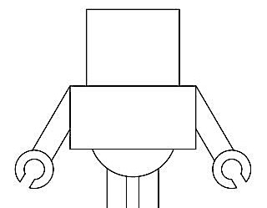
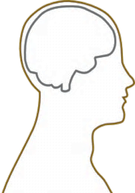

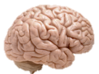
Outline
Engineering the brain
Reverse engineering the brain
Artificial Intelligence: to build intelligent information processing systems in silico
Machine Learning: to use statistical principles to optimize information processing systems
Psychology: to understand the organisation of behavior and its foundations in cognition
Neuroscience: to understand neural coding and computation, and localise brain function

Slide 9


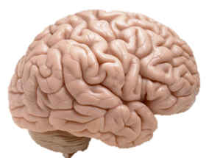




Why are we here?
predator-prey interactions
consumer behavior
mind / brain
social group dynamics
global finance
education
mental health

Slide 10
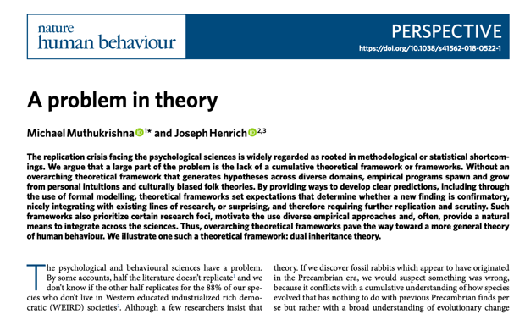
A problem in theory
“Many subfields within psychology…lack any overarching, integrative general theoretical framework that would allow researchers to derive specific predictions from more general premises”
“Rather than building up principles that flow from overarching theoretical frameworks, psychology textbooks are largely a potpourri of disconnected empirical findings on topics that have been popular at some point in the discipline’s history, and clustered based on largely American and European folk categories"
Notes:
Thank you all for coming, it’s a particular pleasure to be here at NYU.
Much of the work that I’m going to describe has been directly inspired by ideas which were first developed here.

Slide 11





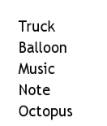

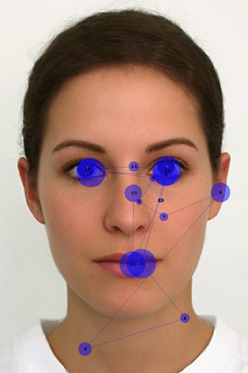
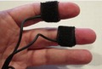
The information processing approach
mind / brain
stimulation
behaviour
?
[model]
input
(known)
computation
(unobservable)
output
(measured)

Slide 12

Interventions

Slide 13
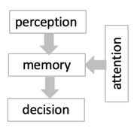
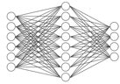
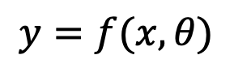
The information processing approach
mind / brain
stimulation
behaviour
$$y=f(x,θ)$$
input
(known)
model
(inferred)
output
(measured)

Slide 14


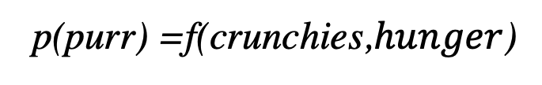
What is a model?
ground truth
simulated (comp. neuro/cog. sci)
simulated
(same cat)
p(purr) =f(crunchies,$hunger$)
crunchies
CPU
(Cat Processing Unit)
purr
simulated
(robotics)
dog
run
simulated (psychology)
“The best model of a cat is another cat, or preferably the same cat”
Norbert Weiner, Founder of Cybernetics

Slide 15
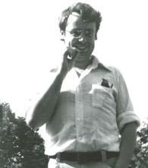
Levels of description
Marr

Slide 16


Approaches
Ecological approach
Accounts for natural environment
Naturalistic tasks
Less constrained models
Data harder to interpret
e.g. study attention during driving simulation
Artificial approach
Overlooks natural environment
Contrived tasks
Well-constrained models
Data easier to interpret
e.g. study attention in the lab

Slide 17
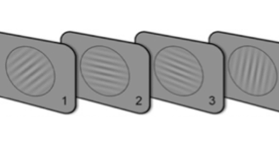

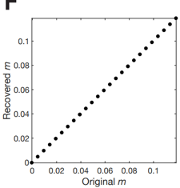
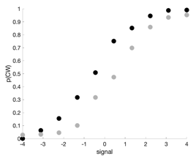
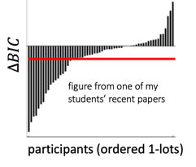
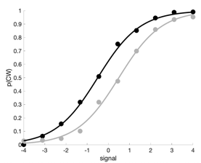
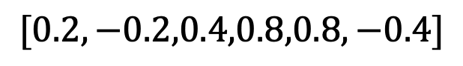
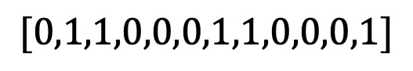
Model fitting: the basics (to be covered later!)
signals
$$[0.2,−0.2,0.4,0.8,0.8,−0.4]$$
choices
$$[0,1,1,0,0,0,1,1,0,0,0,1]$$
participants
stimuli
raw data
summaries
recovery
model fits
simulations

Slide 18
What nobody teaches you
You can read thousands of papers about how to compute model evidence and compare models (and this course will help!).
what actually
happens here?
vague thoughts about cognition/computation
sit down to write model
But nobody ever tells you how to identify the space of models that you should consider in the first place.

Slide 19
Limitless models
The universe of models is theoretically limitless.
How do I know if my model space is sensible or not?
So, how do I know where to start?
D
A
C
B
space of models considered
universe of models

Slide 20




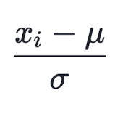
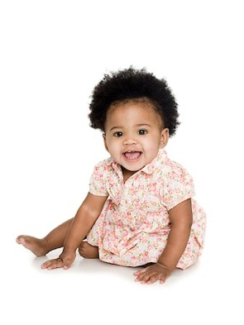
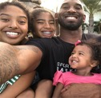
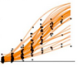

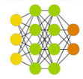
Inductive biases
prior beliefs
computational constraints

Slide 21



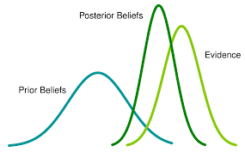

The search for a unified theory
1900
1920
1940
1960
1980
2000
2020
behaviourism
Pavlov
Watson
Skinner
connectionism
Hinton, McClelland
DiCarlo
Bayesianism
Tenebaum, Friston
cognitivism
Marr, Chomsky
Posner, Shallice

Slide 22
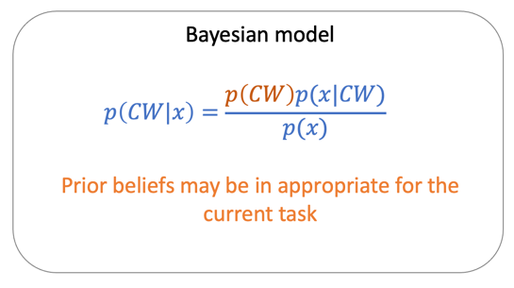
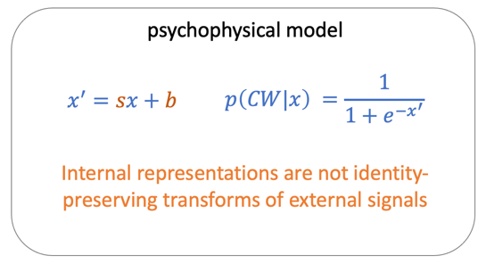
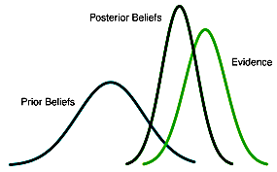



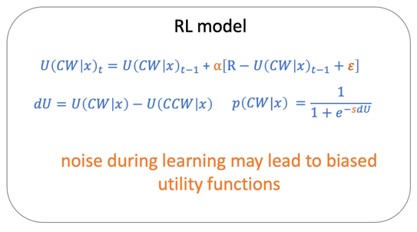
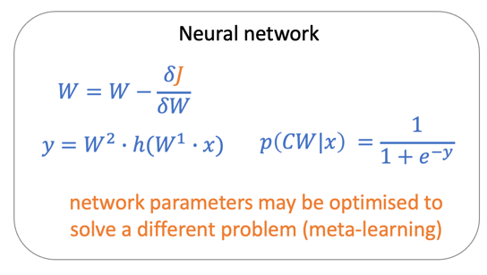
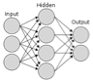
Model classes
Bayesianism
cognitivism
behaviourism
connectionism

Slide 23
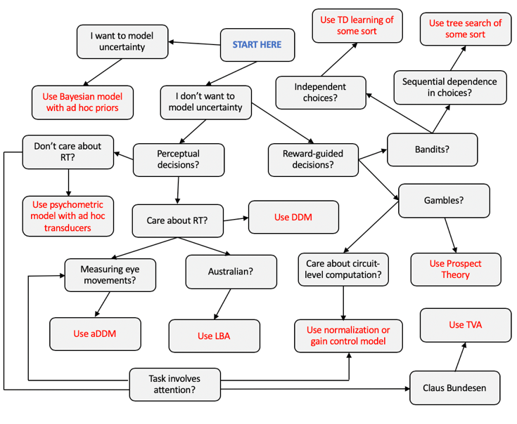
Solution 1: use past models as theories
Science is an incremental endeavour.
So, many people use a sort of mental modelling cheat sheet that involves copying what others have done.
BUT sometimes this is done without thinking very hard about why (more on this later).

Slide 24
Solution 2: take a normative stance
I have absolutely no idea how people do this task
People must be Bayesian!
I built the task, so I know the generative model. I just need to assume that people optimally invert this model for inference.
I don’t even need any free parameters!
Problem solved!
c.f. Anderson, rational analysis
People evolved from slimy things by natural selection
Bayesian solutions are optimal
Natural selection means clever things tend to prosper
People must be optimal
People are still around, so they must be clever
Evolution has been going on for a really long time

Slide 25
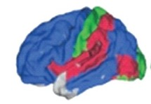
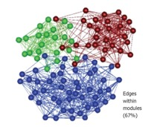
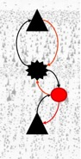
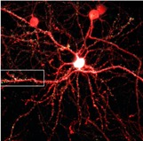
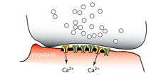
Solution 3: draw inspiration from neurobiology
systems
networks
circuits
cells
synapses
There are at least 50,000 neuroscientists out there. And they know some stuff (a little, at least).
We can draw inspiration from what we know about the brain to build our models. For example, tuning curves are Gaussian, neurons are mutually inhibitory, and exhibit recurrent excitation, coding is adaptive in time and space, etc, etc.

Slide 26

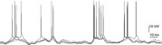
Solution 4: design a cost function instead
weights
weights
cost function:
minimise classification error
minimise reconstruction error
maximise external reward
+ intrinsic costs
etc
weights
Why not forget hand-designing your model? Focus on the optimisation principle instead. If the network is powerful enough, it will learn the requisite set of computations through raw function approximation.
But….interpretability!
Marblestone et al

Slide 27
Predicting and explaining
greater predictive power
models
Handcrafted model with a few params
Neural network with millions of parameters
greater explanatory power
Models are useful for predicting and explaining, and these two virtues typically trade off with complexity

Slide 28
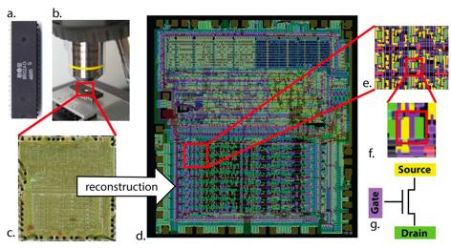
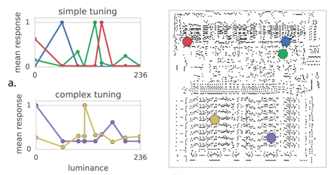
Be humble about your model
Take a system that is fully understood because we built it (e.g. a microprocessor)
do cognitive neuroscience e.g. single cell recordings, brain imaging, lesion studies
Results reveals tuning curves, connectivity profiles, lesion-symptom maps and oscillatory activity just as in the real brain.
But we know that the interpretative logic applied to these phenomena is completely wrong!
Jonas & Kording 2017

Slide 29
Thanks
Moltes
Gràcies

